Slide 1

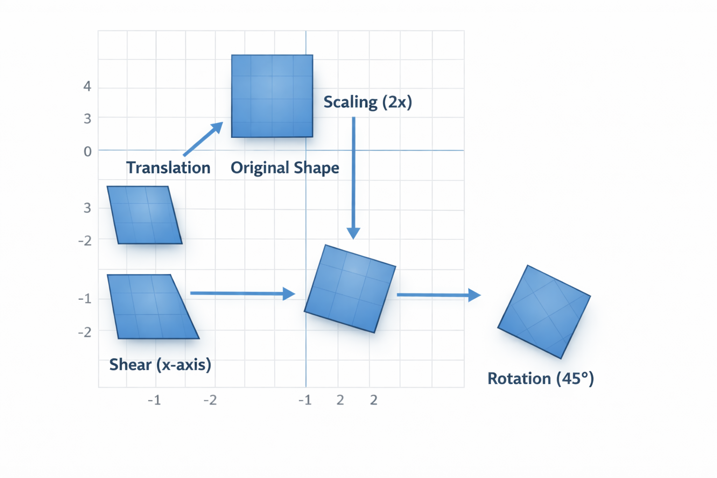
Computer Graphics 2D Transformation
Lecture 6
Nazmun Nessa Moon
Associate Professor Department of Computer Science and Engineering Daffodil International University, DIU
1
Notes:
1

Slide 2
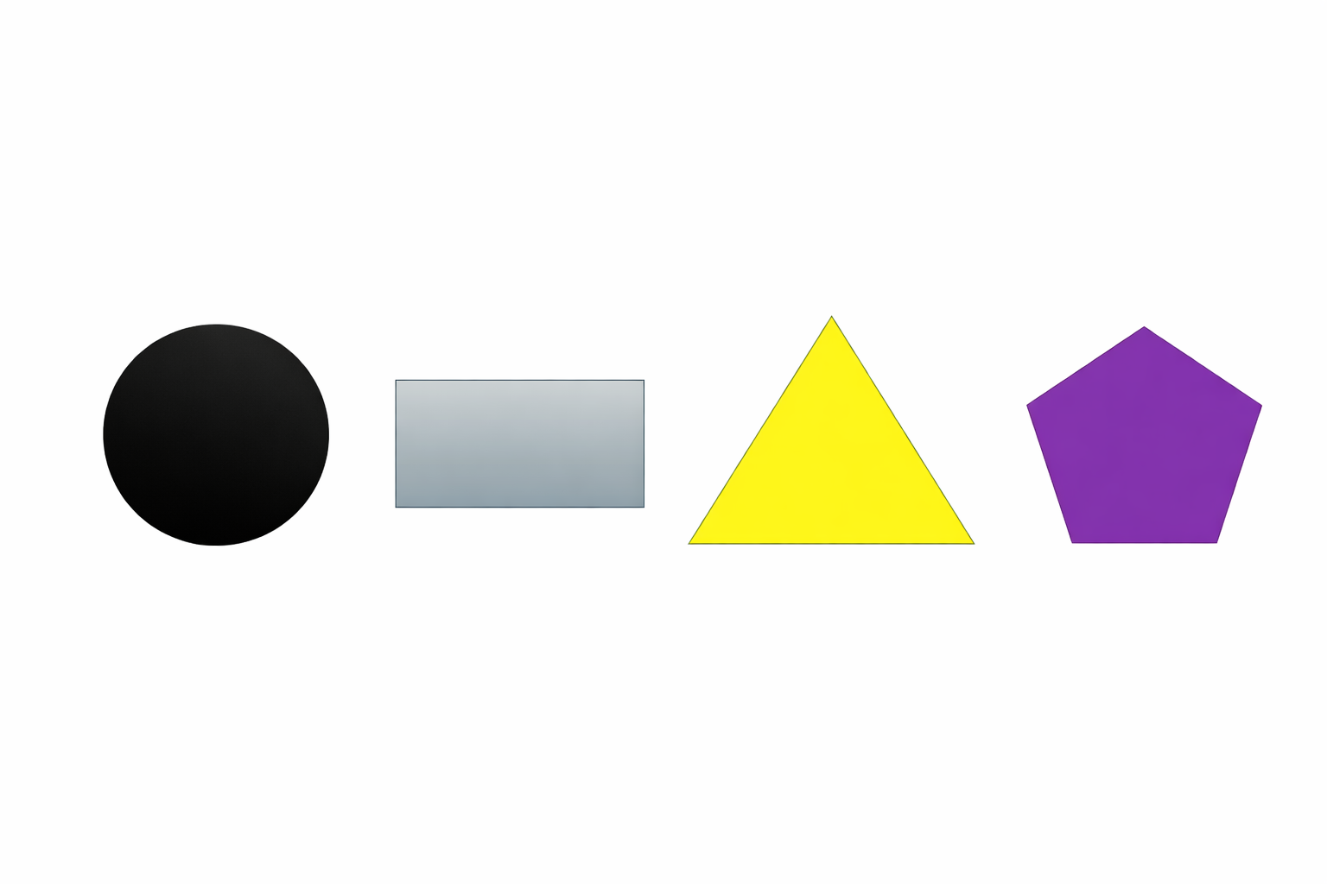
Transformations
What are transformations?
The geometrical changes of an object from a current state to a modified state.
Why are the transformations needed?
To manipulate the initially created object and to display the modified object without having to redraw it.
Two-Dimensional Shape: That which has two dimensions, i.e., height and width.
2D shapes do not have any thickness.
A point is 2-dimensional, and a line is one-dimensional.
Example of 2-Dimensional Shapes:
Department of CSE, Daffodil International University
2

Slide 3
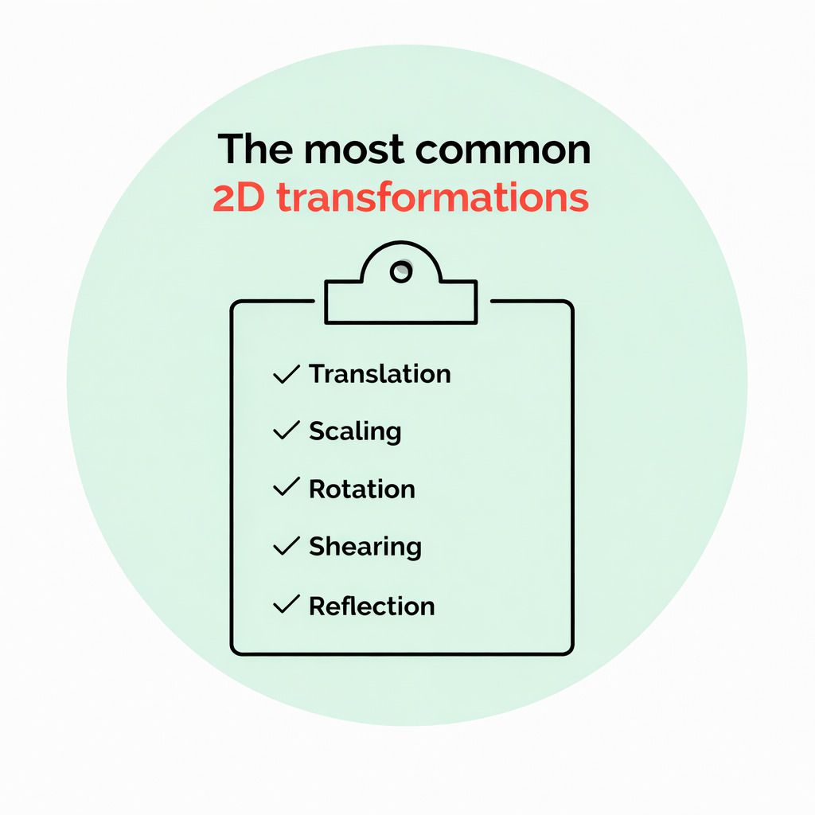
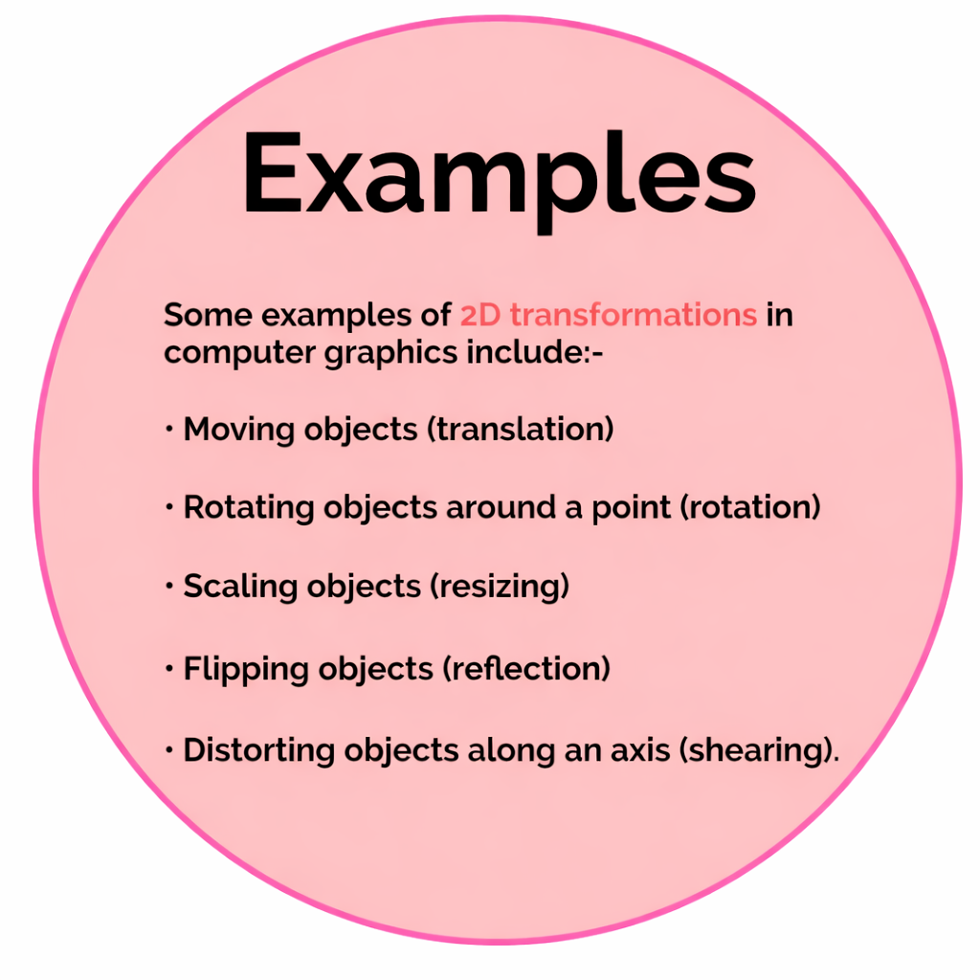
2D Transformations Types
Department of CSE, Daffodil International University
3

Slide 4
Applications of 2D Transformations
Computer Animation & Games: Movement is created by translating objects over time, while rotation and scaling simulate changes in orientation and distance.
Computer-Aided Design (CAD): Designers use scaling to zoom, rotation to adjust components, and shearing to change shapes in drafting software.
Image Processing & Editing: Digital images are transformed using reflection to mirror objects, rotation to align, and scaling to resize.
Graphical User Interfaces (GUIs): Windows, icons, and menus are positioned, resized, and moved using translation and scaling.
Modeling & Viewing: Geometrical transformations are used to map 2D scenes to different viewports, allowing for zooming effects and changing viewing perspectives.
Department of CSE, Daffodil International University
4

Slide 5
2D Transformations (Translation)
Translation is a process of changing the position of an object in a straight-line path from one coordinate location to another.
We can translate a two-dimensional point by adding translation distances, tx and ty.
Suppose the original position is (x, y); then the new position is (x′, y′).
Translation of objects
Here,
x′ = x + tx (This denotes translation towards X axis.)
y′ = y + ty (This denotes translation towards Y axis.)
Department of CSE, Daffodil International University
5

Slide 6
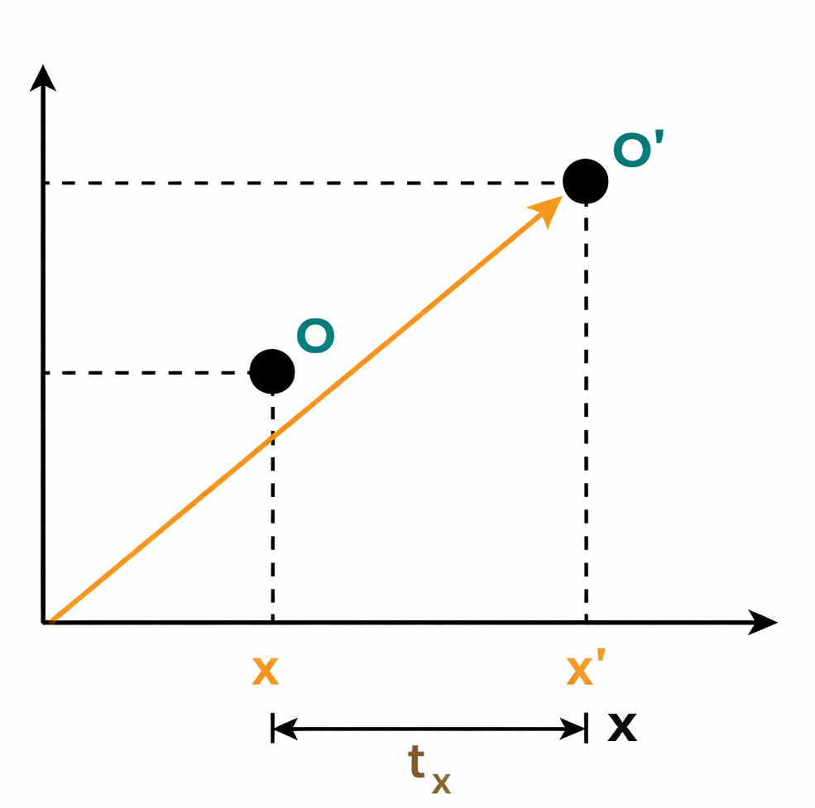
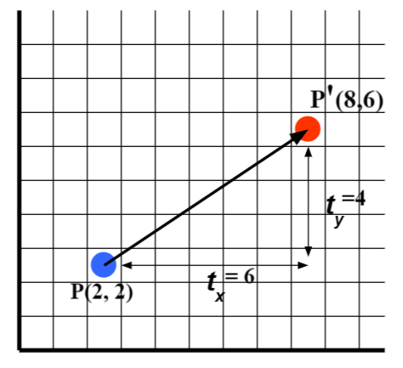

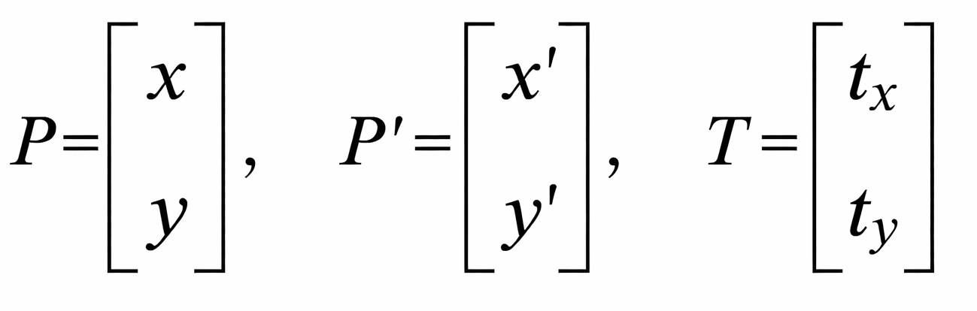
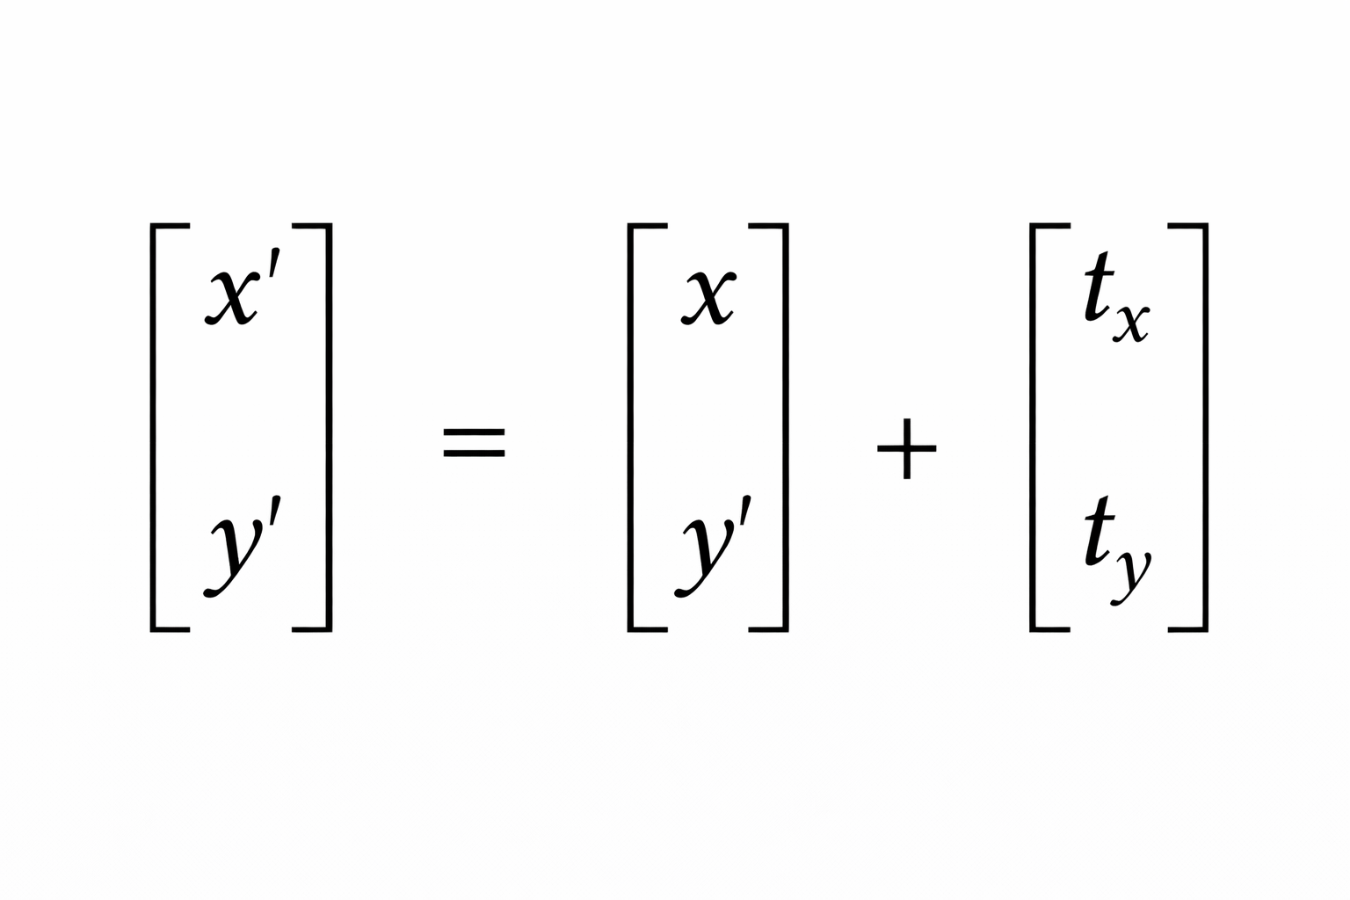

2D Transformations (Translation)
x′ = x + tx
y′ = y + ty
Represent in a matrix.
o(55, 60)
(20,35)
(45, 30)
(65, 30)
(10,5)
(30,5)
Department of CSE, Daffodil International University
6

Slide 7
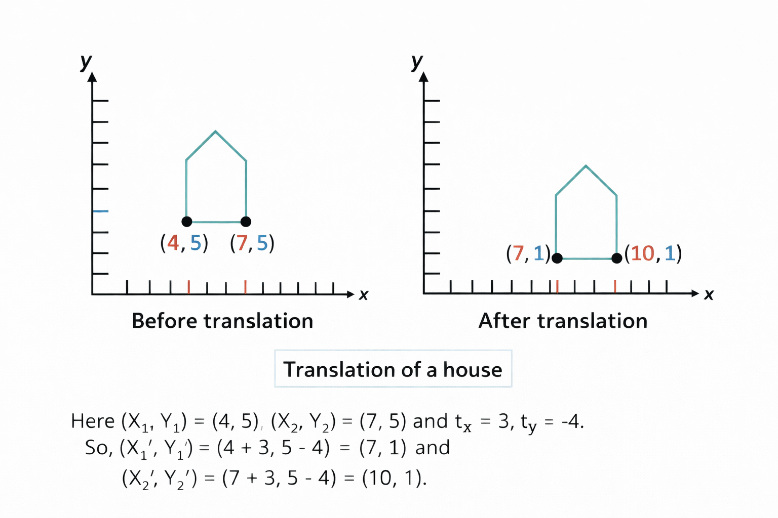
2D Transformations (Translation Example)
Department of CSE, Daffodil International University
7

Slide 8

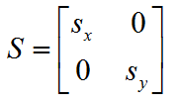



2D Transformations (Scaling)
A scaling transformation changes the size of an object.
This operation can be carried out for polygons by multiplying the coordinate values (x, y) of each vertex by scaling factors Sx and Sy to produce the transformed coordinates (x′, y′).
x′ = xS_{x}
y′ = yS_{y}
Represent in a matrix.
•
Scaling of objects
Department of CSE, Daffodil International University
8

Slide 9
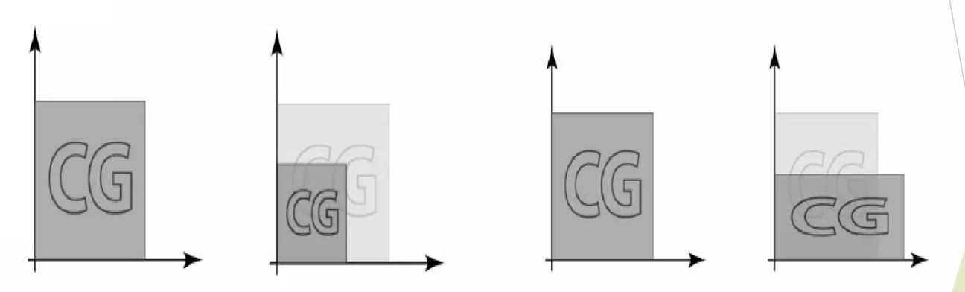
2D Transformations (Scaling)
(4,4)
(2,2)
Sx = 2, Sy = 2
(2,2)
(1,1)
Department of CSE, Daffodil International University
9

Slide 10
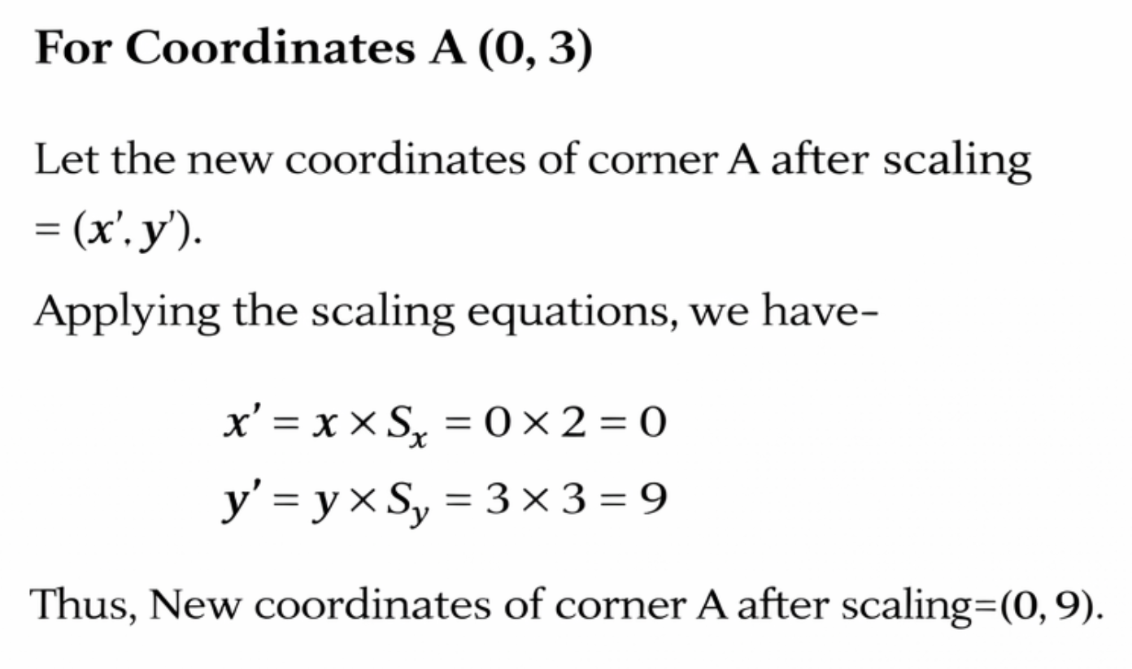
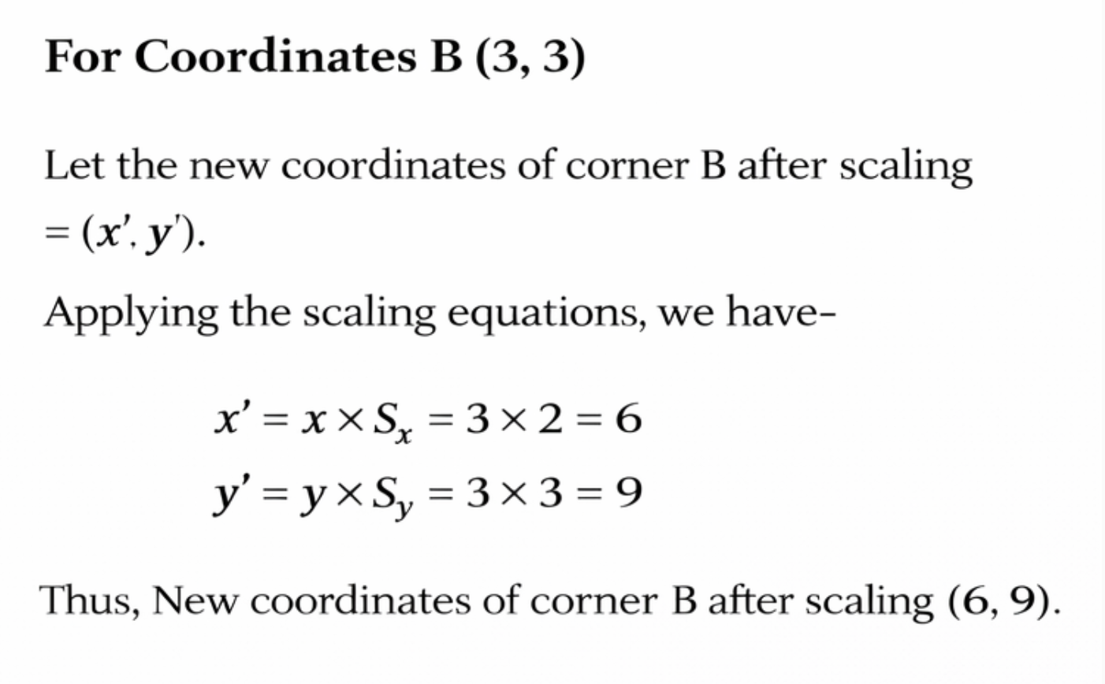
2D Transformations (Scaling Example)
Given a square object with coordinate points A(0, 3), B(3, 3), C(3, 0), and D(0, 0). Apply the scaling parameter 2 towards the X axis and 3 towards the Y axis and obtain the new coordinates of the object.
Solutions:
Given-
Old corner coordinates of the square = A (0, 3), B(3, 3), C(3, 0), D(0, 0)
Scaling factor along X axis, S_{x}= 2
Scaling factor along Y axis, S_{y}= 3
Department of CSE, Daffodil International University
10

Slide 11
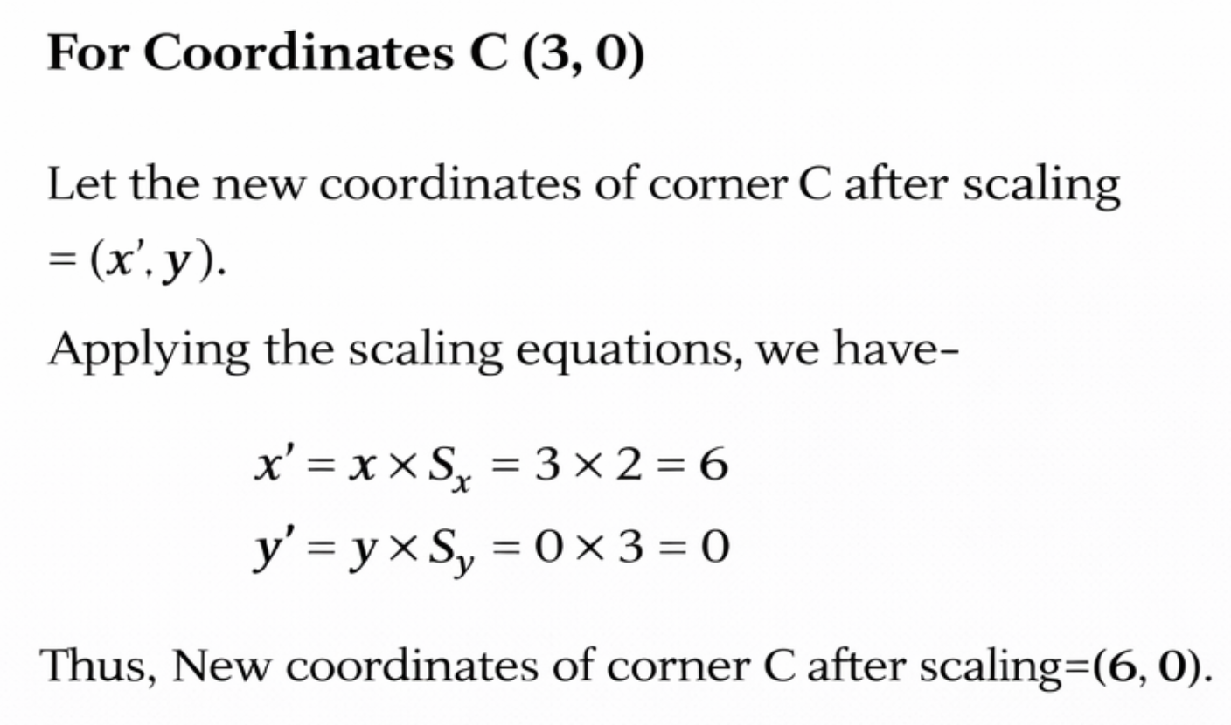
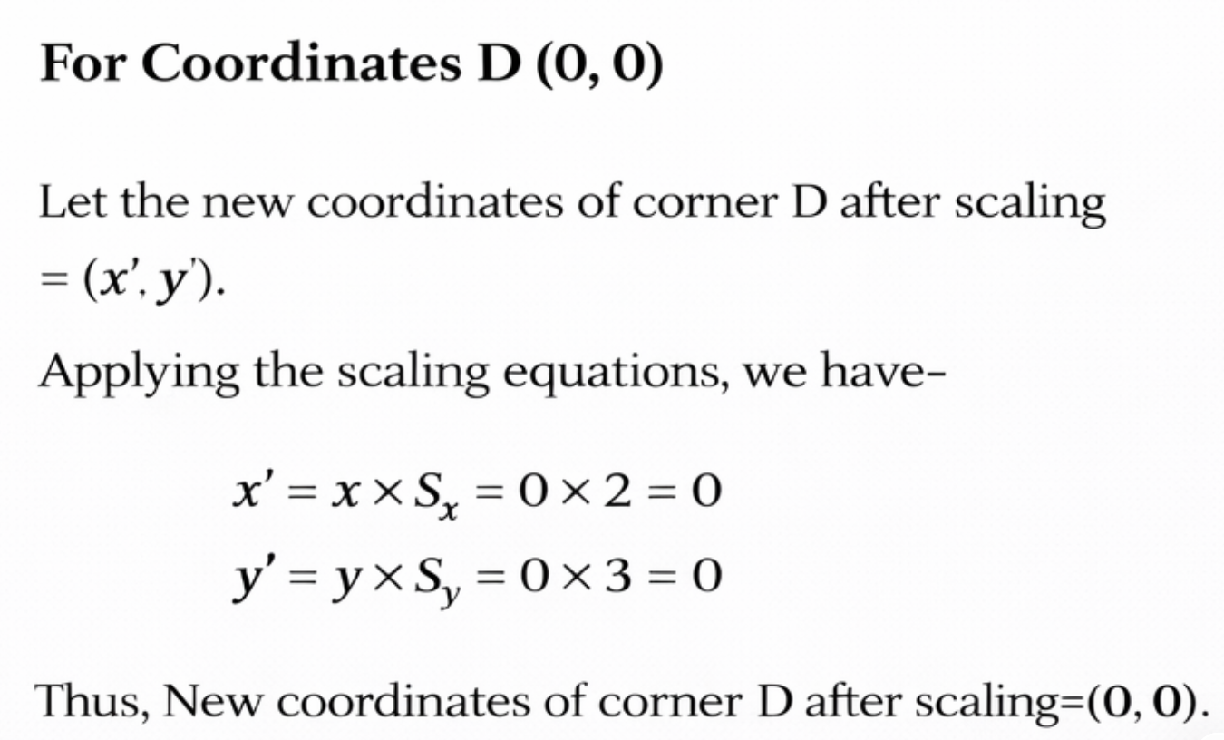
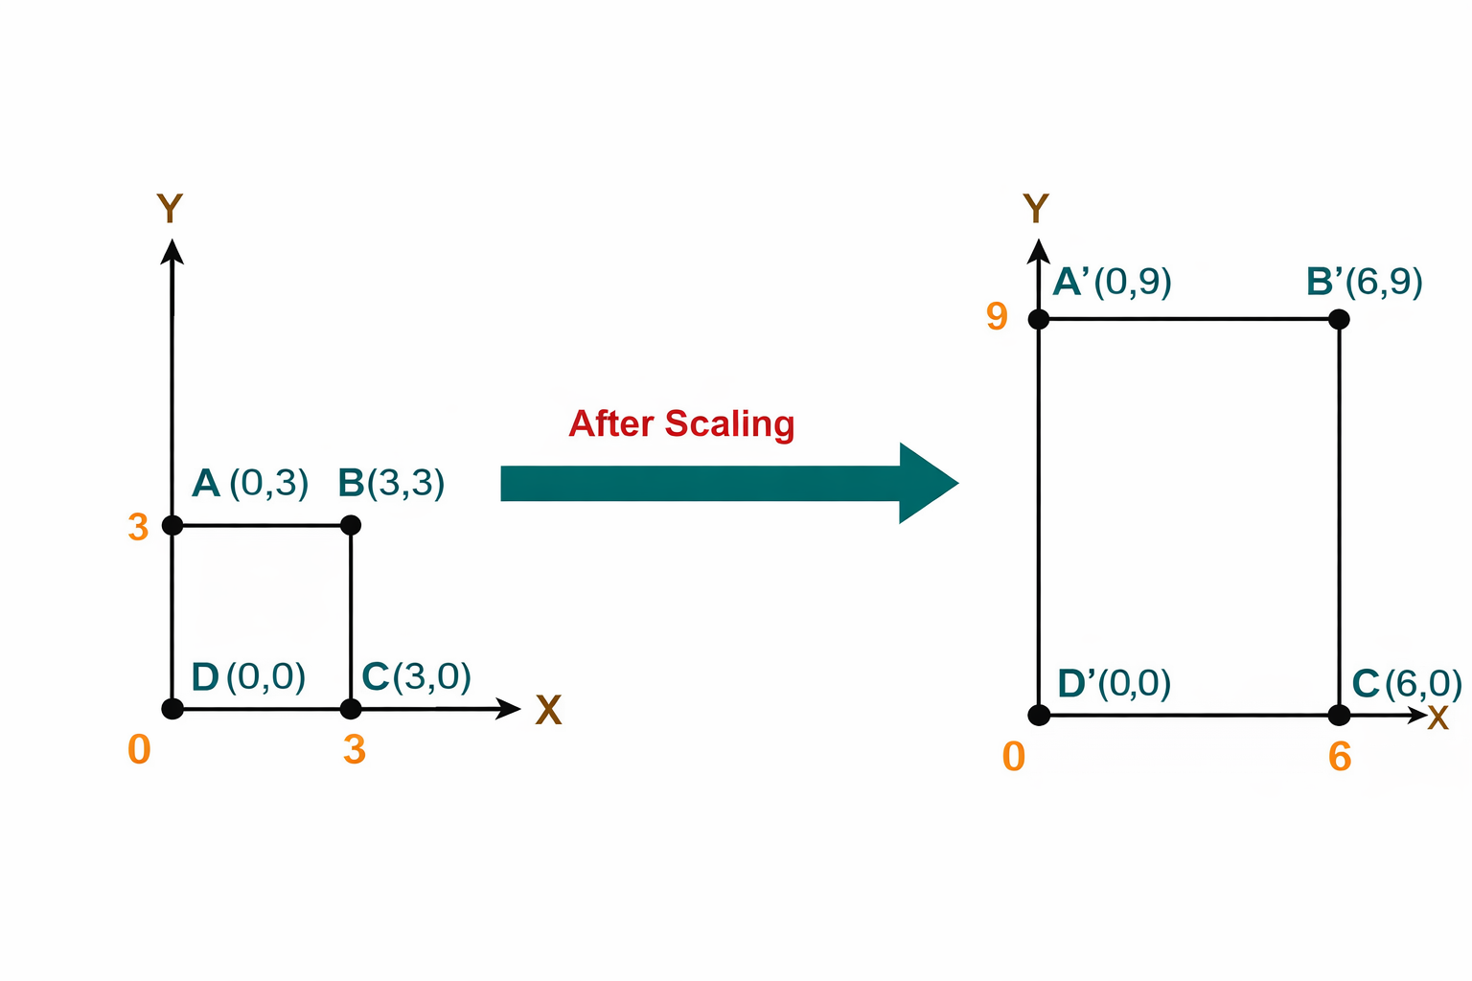
2D Transformations (Scaling Example)
Given a square object with coordinate points A(0, 3), B(3, 3), C(3, 0), and D(0, 0). Apply the scaling parameter 2 towards the X axis and 3 towards the Y axis and obtain the new coordinates of the object.
Solutions:
Department of CSE, Daffodil International University
11

Slide 12
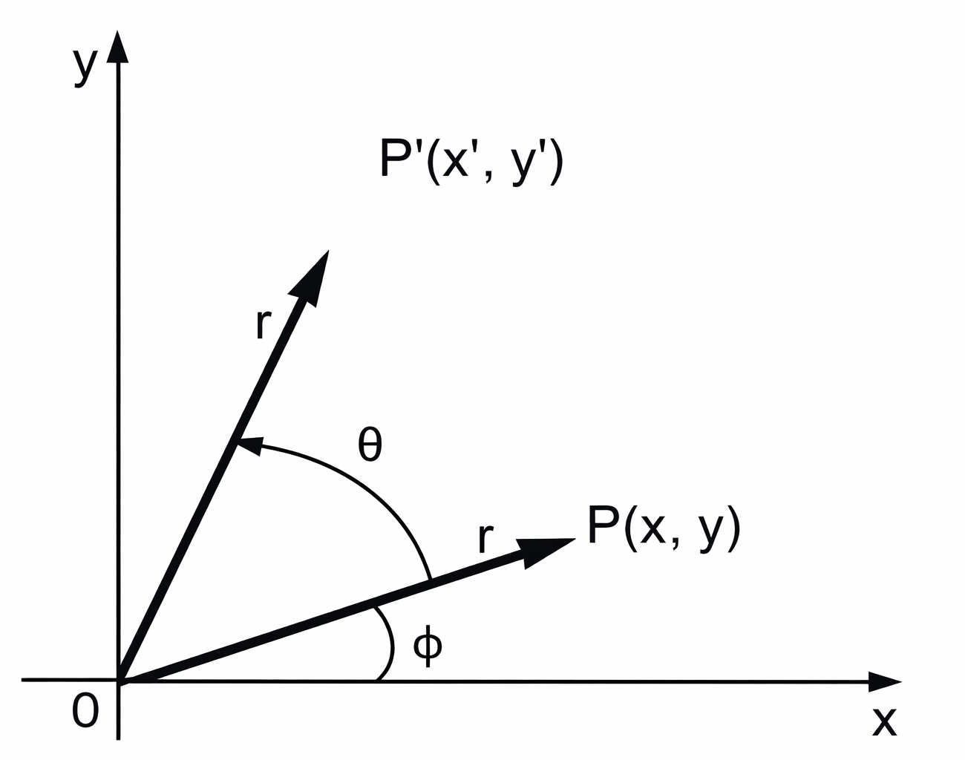
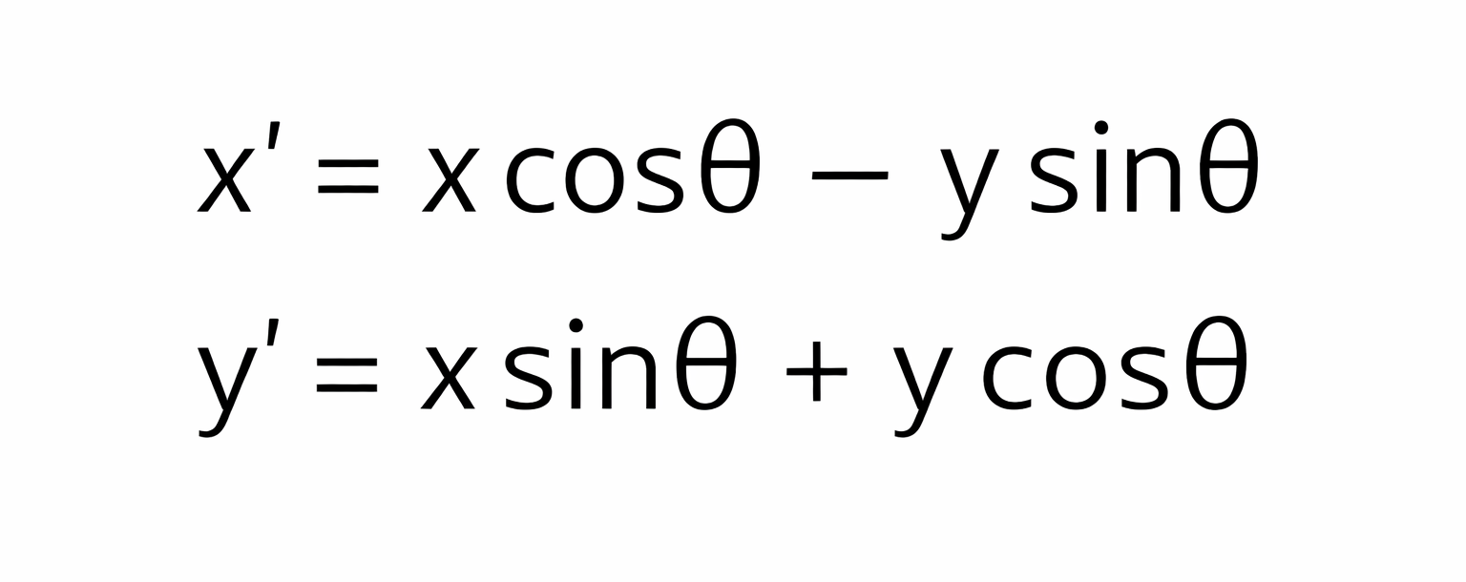
2D Transformations (Rotation)
A two-dimensional rotation is applied to an object by repositioning it along a circular path in the xy-plane.
Initial angle of the object P with respect to origin = Φ
Rotation angle = θ
Let us suppose you want to rotate it at the angle θ. After rotating it to a new location, you will get a new point P’ (x’, y’).
This rotation is achieved by using the following rotation equations:
Rotation of objects
Department of CSE, Daffodil International University
12

Slide 13

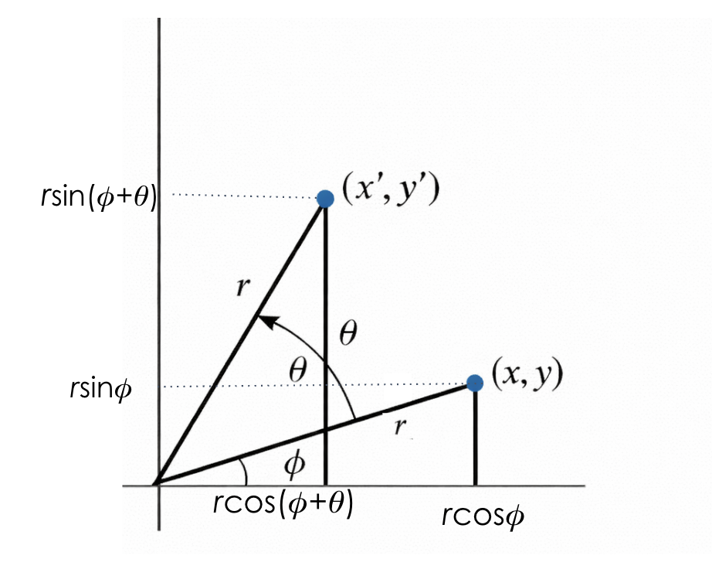



2D Transformations (Rotation)
Derivation of the rotation:
Department of CSE, Daffodil International University
13

Slide 14

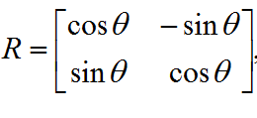
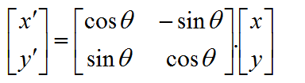

2D Transformations (Rotation)
Derivation of the rotation (continued):
Rewriting in matrix form gives us :
Department of CSE, Daffodil International University
14

Slide 15
2D Transformations (Rotation Example)
Given a line segment with starting point as (0, 0) and ending point as (4, 4). Apply a 30-degree rotation in the anticlockwise direction on the line segment and find out the new coordinates of the line.
Solutions:
We rotate a straight line by its end points with the same angle. Then, we redraw a line between the new end points.
Given-
Old ending coordinates of the line = (x, y) = (4, 4)
Rotation angle = θ = 30º
Let the new ending coordinates of the line after rotation be (x’, y’).
Applying the rotation equations, we have
x′
= xcosθ – ysinθ
= 4 x cos30º – 4 x sin30º
= 4 x (√3 / 2) – 4 x (1 / 2)
= 2√3 – 2
= 2(√3 – 1)
= 2(1.73 – 1)
= 1.46
y′
= xsinθ + ycosθ
= 4 x sin30º + 4 x cos30º
= 4 x (1 / 2) + 4 x (√3 / 2)
= 2 + 2√3
= 2(1 + √3)
= 2(1 + 1.73)
= 5.46
Thus, the new ending coordinates of the line after rotation are (1.46, 5.46).
Department of CSE, Daffodil International University
15

Slide 16
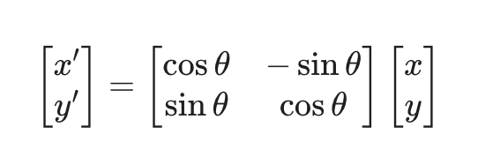
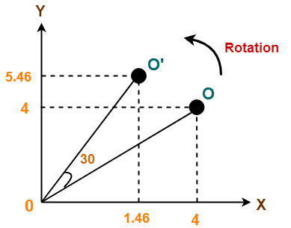
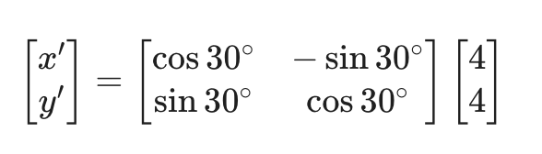
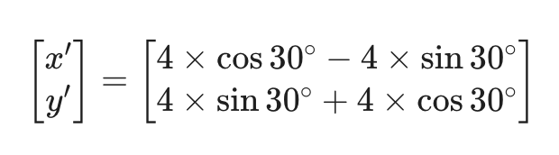
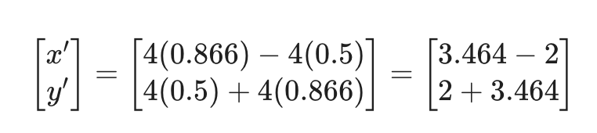
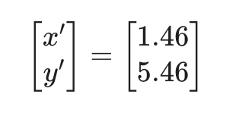
2D Transformations (Rotation Example)
Alternatively,
In matrix form, the new ending coordinates of the line after rotation may be obtained as
Thus, the new ending coordinates of the line after rotation are (1.46, 5.46).

Slide 17
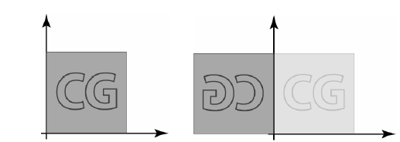
2D Transformations (Reflection)
Reflection is the mirror image of the original object. In other words, we can say that it is a rotation operation with 180°.
In reflection transformation, the size of the object does not change.
Department of CSE, Daffodil International University
17

Slide 18
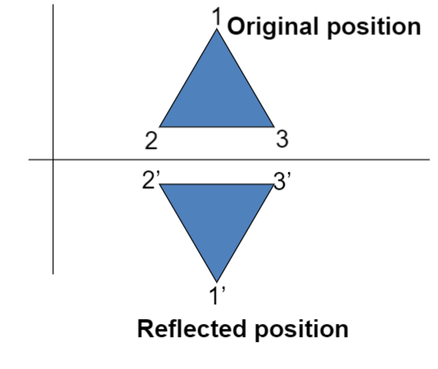
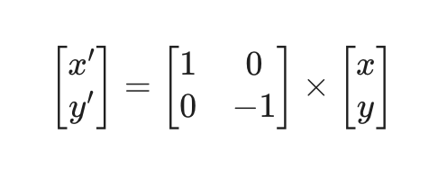
2D Transformations (Reflection)
Reflection on X-Axis:
Reflection about the line y = 0, the X-axis, is accomplished with the transformation matrix.
This reflection is achieved by using the following reflection equations:
x’ = x
y’= -y
Department of CSE, Daffodil International University
18

Slide 19
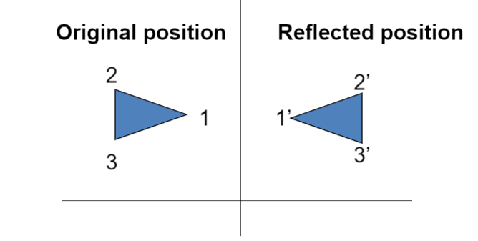
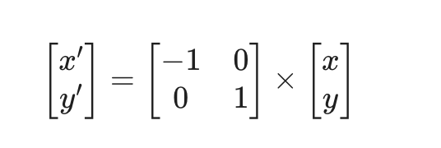
2D Transformations (Reflection)
Reflection on Y-Axis:
Reflection about the line x = 0, the Y-axis, is accomplished with the transformation matrix.
This reflection is achieved by using the following reflection equations:
x’ = -x
y’= y
Department of CSE, Daffodil International University
19

Slide 20
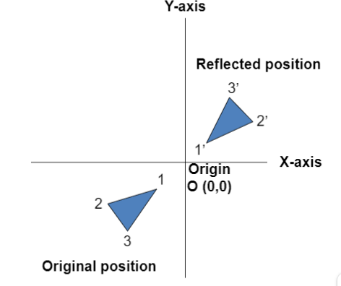
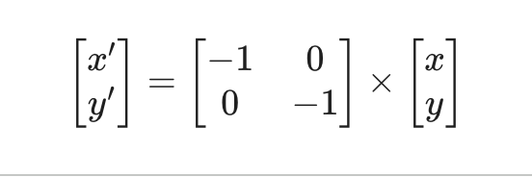
2D Transformations (Reflection)
Reflection about an axis perpendicular to xy plane and passing through origin:
The matrix of this transformation is given below
This reflection is achieved by using the following reflection equations:
x’ = -x
y’= -y
In this value of x and y, both will be reversed. This is also called a half revolution about the origin.
Department of CSE, Daffodil International University
20

Slide 21
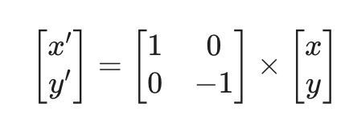
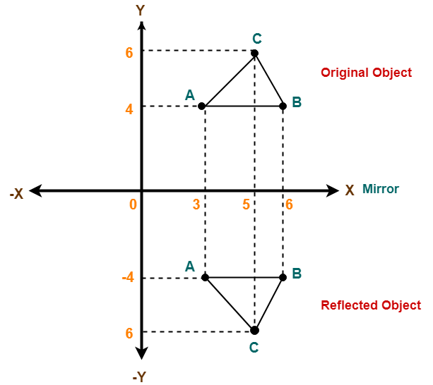
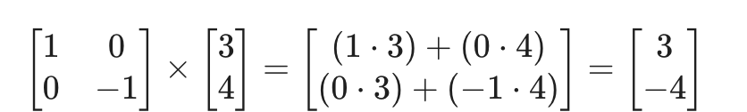
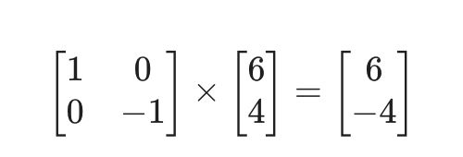
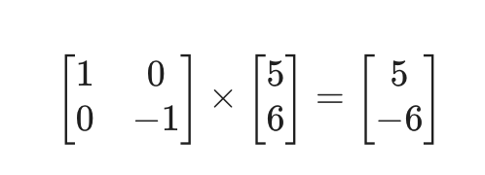
2D Transformations (Scaling Example)
Given a triangle with coordinate points A(3, 4), B(6, 4), and C(5, 6). Apply the reflection on the X axis and obtain the new coordinates of the object.
Solutions:
For a reflection across the x-axis, the matrix equation is:
For Point A (3, 4):
For Point B (6, 4):
For Point C(5, 6):
New Point: A' = (3, -4), B' = (6, -4), C' = (5, -6)
Department of CSE, Daffodil International University
21

Slide 22
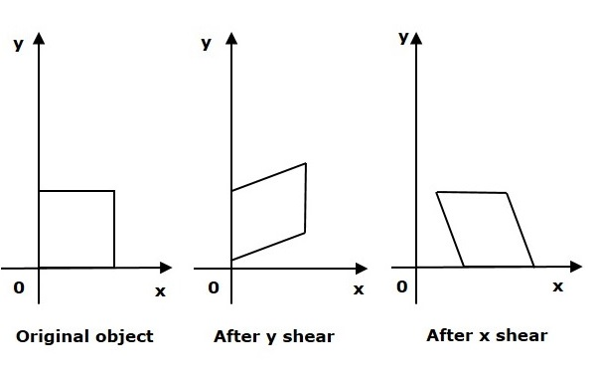
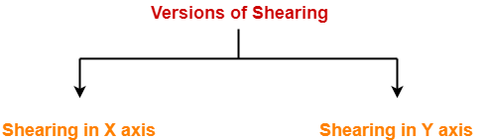
2D Transformations (Shearing)
Shear is a transformation that distorts the shape of an object such that the transformed shape appears as if the object were composed of internal layers that had been caused to slide over each other
Two common shearing transformations are those that shift coordinate x values and those that shift y values
Department of CSE, Daffodil International University
22

Slide 23
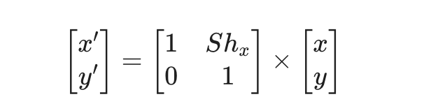
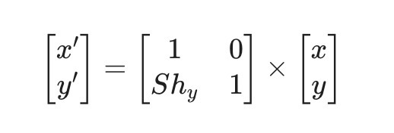
2D Transformations (Shearing)
Consider a point object O that has to be sheared in a 2D plane.
Let-
Initial coordinates of the object O = (X, Y)
Shearing parameter towards X direction = Sh_{x}
Shearing parameter towards Y direction = Sh_{y}
New coordinates of the object O after shearing = (X, Y)
Shearing in X Axis-
Shearing in X axis is achieved by using the following shearing equations:
x’ = x + Sh_{x} . y
y’= y
Shearing in Y Axis-
Shearing in Y axis is achieved by using the following shearing equations:
x’= x
y’ = y + Sh_{y}. x
In Matrix form, the above shearing equations may be represented as
In Matrix form, the above shearing equations may be represented as
Department of CSE, Daffodil International University
23

Slide 24
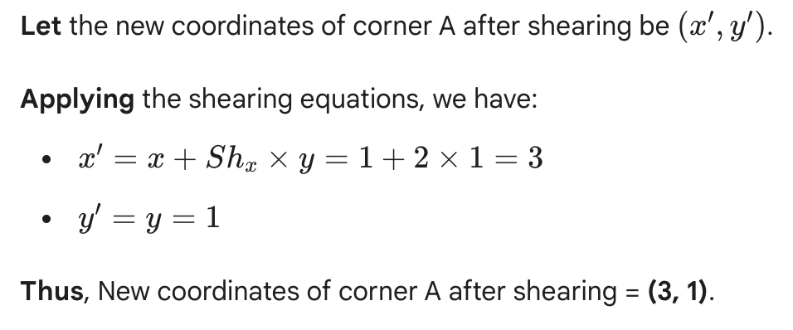
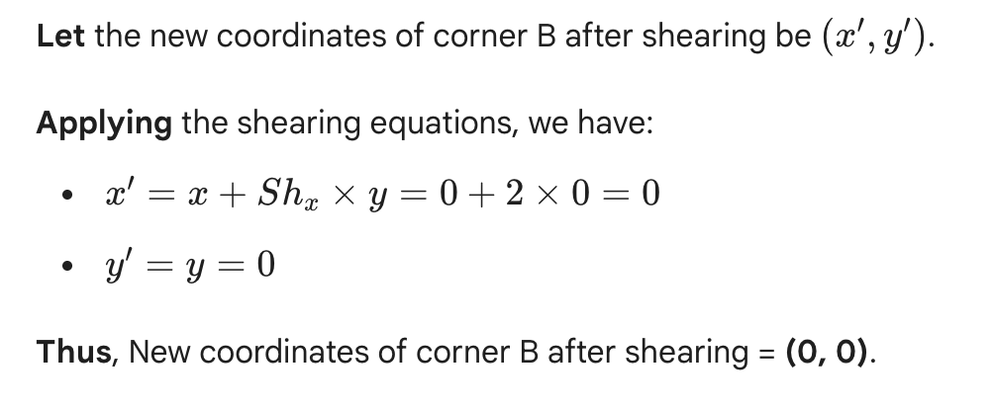
2D Transformations (Shearing Example)
Given a triangle with points (1, 1), (0, 0) and (1, 0). Apply shear parameter 2 on X axis and 2 on Y axis and find out the new coordinates of the object.
Solutions:
Initial coordinates of the triangle = A (1, 1), B(0, 0), C(1, 0)
Shearing parameter towards X direction Sh_{x} = 2
Shearing parameter towards Y direction Sh_{y}= 2
Shearing in X Axis-
For Coordinates A(1, 1)
For Coordinates B(0, 0)
Department of CSE, Daffodil International University
24

Slide 25
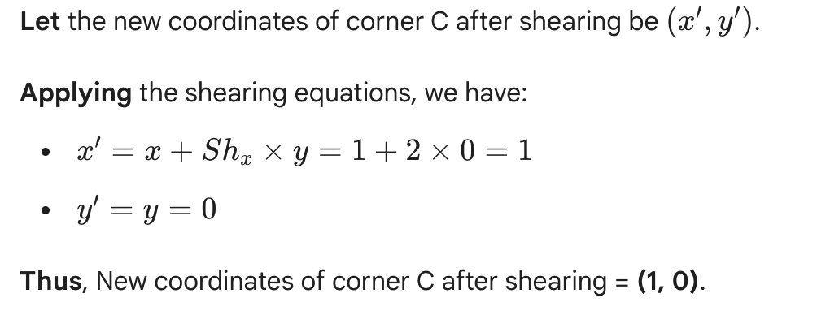
2D Transformations (Shearing Example)
Given a triangle with points (1, 1), (0, 0) and (1, 0). Apply shear parameter 2 on the X axis and 2 on the Y axis and find out the new coordinates of the object.
Solutions:
For Coordinates C(1, 0)
Thus, New coordinates of the triangle after shearing in X axis = A (3, 1), B(0, 0), C(1, 0).
Department of CSE, Daffodil International University
25

Slide 26
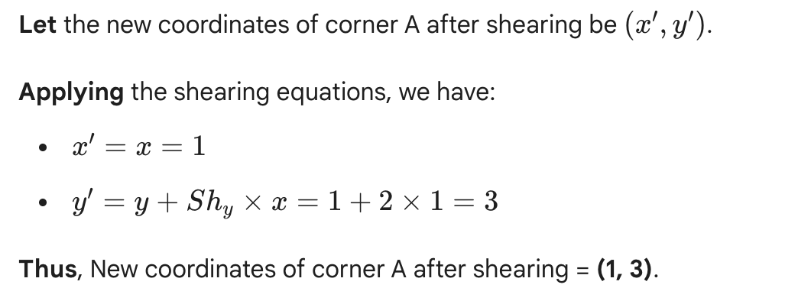
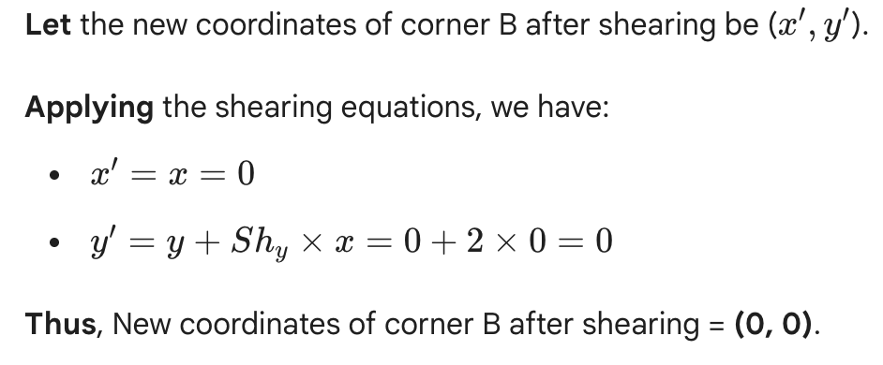
2D Transformations (Shearing Example)
Given a triangle with points (1, 1), (0, 0) and (1, 0). Apply shear parameter 2 on X axis and 2 on Y axis and find out the new coordinates of the object.
Solutions:
Initial coordinates of the triangle = A (1, 1), B(0, 0), C(1, 0)
Shearing parameter towards X direction Sh_{x} = 2
Shearing parameter towards Y direction Sh_{y}= 2
Shearing in Y Axis-
For Coordinates A(1, 1)
For Coordinates B(0, 0)
Department of CSE, Daffodil International University
26

Slide 27
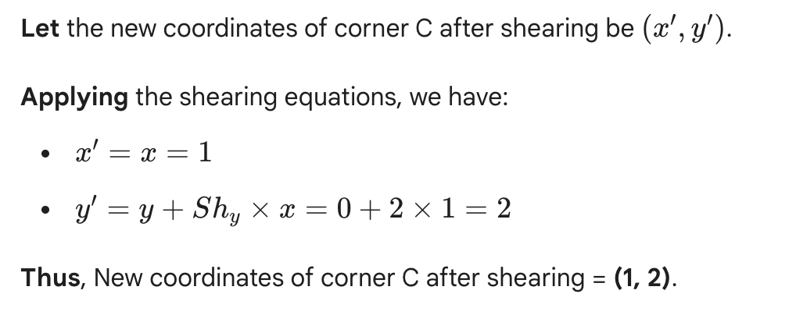
2D Transformations (Shearing Example)
Given a triangle with points (1, 1), (0, 0) and (1, 0). Apply shear parameter 2 on the X axis and 2 on the Y axis and find out the new coordinates of the object.
Solutions:
For Coordinates C(1, 0)
Thus, New coordinates of the triangle after shearing in Y axis = A (1, 3), B(0, 0), C(1, 2).
Department of CSE, Daffodil International University
27

Slide 28
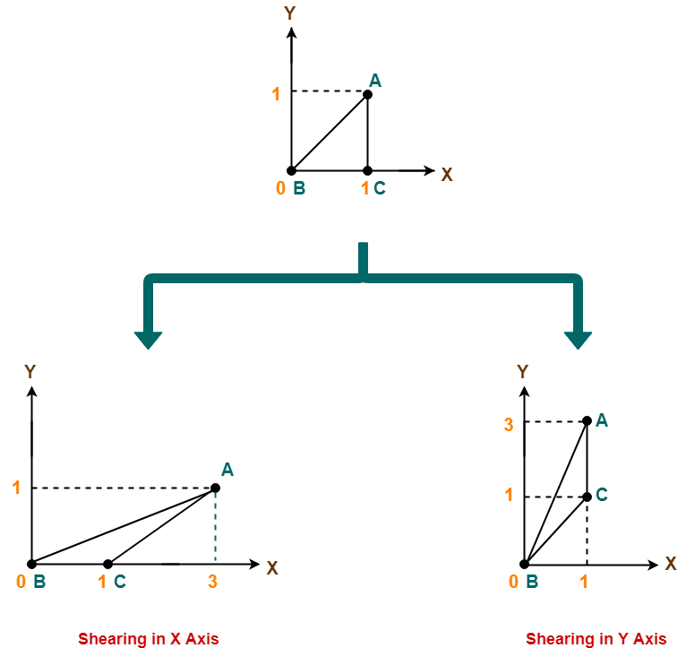
2D Transformations (Shearing Example)
Department of CSE, Daffodil International University
28

Slide 29

Department of CSE, Daffodil International University
29
Notes:
29

